Slide 1
How to write a WoW Bot
Steve Rowe
12-Dec-2008

Slide 2
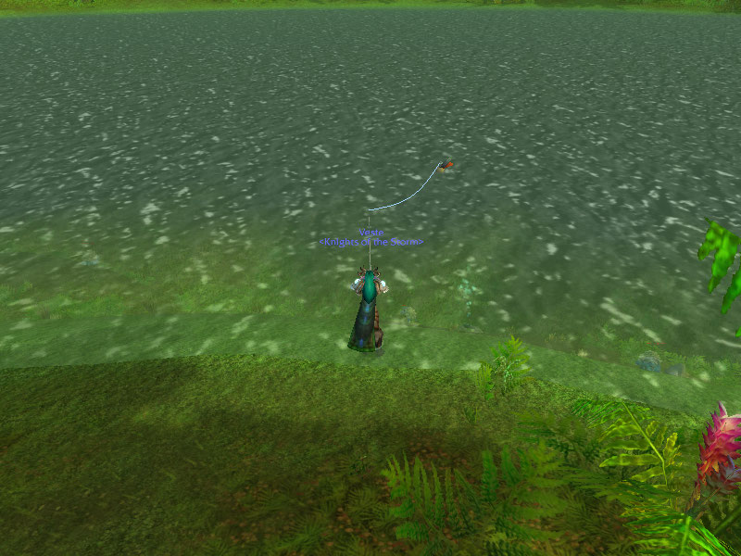
Fishing in WoW

Slide 3
How a Human Does It
Use the “fish” power to cast.
Wait for the bobber to show up.
Position the cursor over the bobber.
Wait for the “splash”.
Right click.

Slide 4
How a Bot Does it:
Use the “fish” power to cast. (Inject events)
Wait for the bobber to show up. (Scrape screen, image processing)
Position the cursor over the bobber. (Inject events)
Wait for the “splash”. (Scrape screen, image processing)
Right click. (Inject events)

Slide 5
Java Implementation Tricks
The java.awt.Robot class is able to perform arbitrary event injection and screen image captures.
The java.awt.image.BufferedImage class allows pixel-level access to an image.

Slide 6
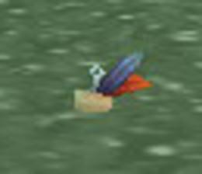
Finding the Bobber
The bobber is in constant motion, so trying to pattern-match against a template is problematic. The hues of the cork match closely to the hues of the ripples in the water. The hues of the blue feather match closely the water itself (for some water). But the red feather stands out.

Slide 7
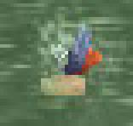
Detecting a Strike
First, tried looking for all the extra white in the image.
Finally, just counted the red pixels.

Slide 8
Results
Tested in Menethil Harbor and Forgotten Pools.
About 5% false positives detecting a strike.
Needed to adjust redness detector and strike detector parameters when I moved to a new location or when the lighting changed.
So I added sliders for those parameters.

Slide 9
Staying Undetected
Don’t name the program “FishBot”.
Removed window text that contained the words “fish”, “bobber”, “strike”, etc.
Don’t make the events mechanical.
Used random timing for keystrokes and mouse clicks.
Used smooth-ish, round-ish motion for mouse.
Be aware of what Warden does.
Don’t leave the computer unattended.

Slide 10
How to Use It
Set WoW to be in 800x600 resolution, Windowed mode.
Move the WoW window to the upper-left corner of your main monitor.
Put the “fish” power into quick slot 1.
Arm your character with the fishing pole, aim it at the water, and scroll to “first-person” view.
Rename the jar file from FishBot.jar to something else.
Double-click the jar file (whatever you name it)

